Slide 1
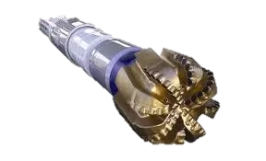
Optimize ROP in drilling with Machine Learning
CREATED BY KHIZR AMIR

Slide 2
CONTENTS
Project Background
Aim
Methodology
Data Analysis
Predictive Analysis
Limitations & Recommendations
Conclusion

Slide 3
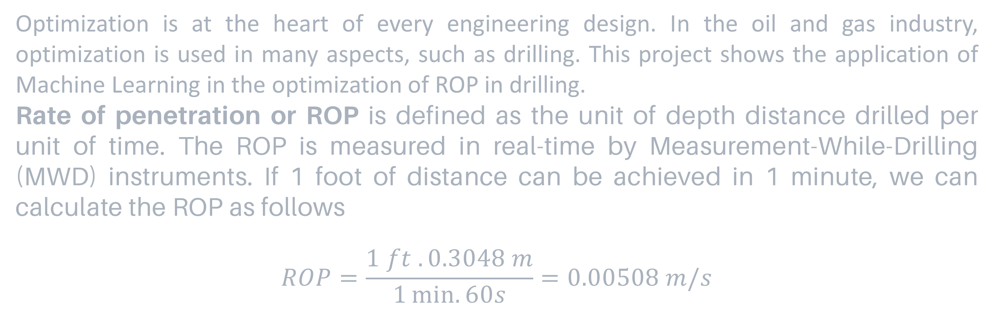
PROJECT BACKGROUND
Optimization is at the heart of every engineering design. In the oil and gas industry, optimization is used in many aspects, such as drilling. This project shows the application of Machine Learning in the optimization of ROP in drilling.
Rate of penetration or ROP is defined as the unit of depth distance drilled per unit of time. The ROP is measured in real-time by Measurement-While-Drilling (MWD) instruments. If 1 foot of distance can be achieved in 1 minute, we can calculate the ROP as follows
$$ROP=\frac{1 ft . 0.3048 m}{1\min{. 60s}}=0.00508 m/s$$

Slide 4
PROJECT BACKGROUND
The higher the ROP, the faster a distance could be achieved
Companies always want to drill as fast as they can to save time. The variables (PHIF, VSH, SW, and KLOGH) are constant variables because they represent the formation. The only variables that a driller can control from the surface are WOB and RPM.
ROP does not always proportionally increasing with increasing WOB and RPM. ROP increases until a point (founder point) where it starts to decrease with a keeping increasing WOB and RPM.

Slide 5
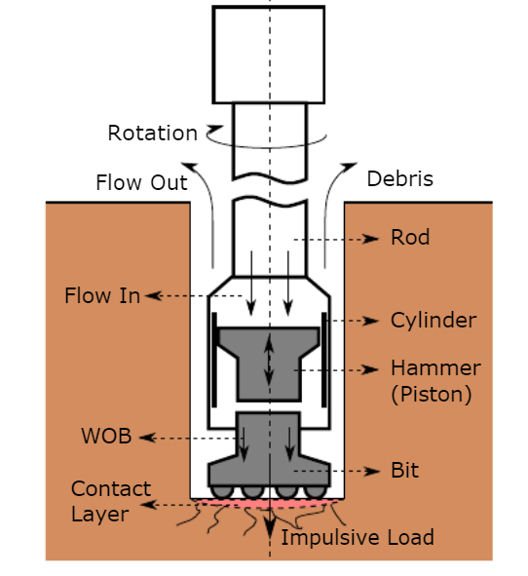
AIM
Our aim in this project is to highlight the application of machine learning in drilling engineering field and drilling analytics. To familiarize ourselves with the components of drilling. A drill string assembly consists of components shown in the schematic below. The weight provided by the drill collar (thick-walled tubular pieces made of steel bars) is in direct interface with the drill bit. This weight is called the Weight On Bit or WOB, defined as the downward force exerted to the drill bit needed to break the rock. Since the drill bit is rotating, the Rotation Per Minute or RPM is measured.

Slide 6
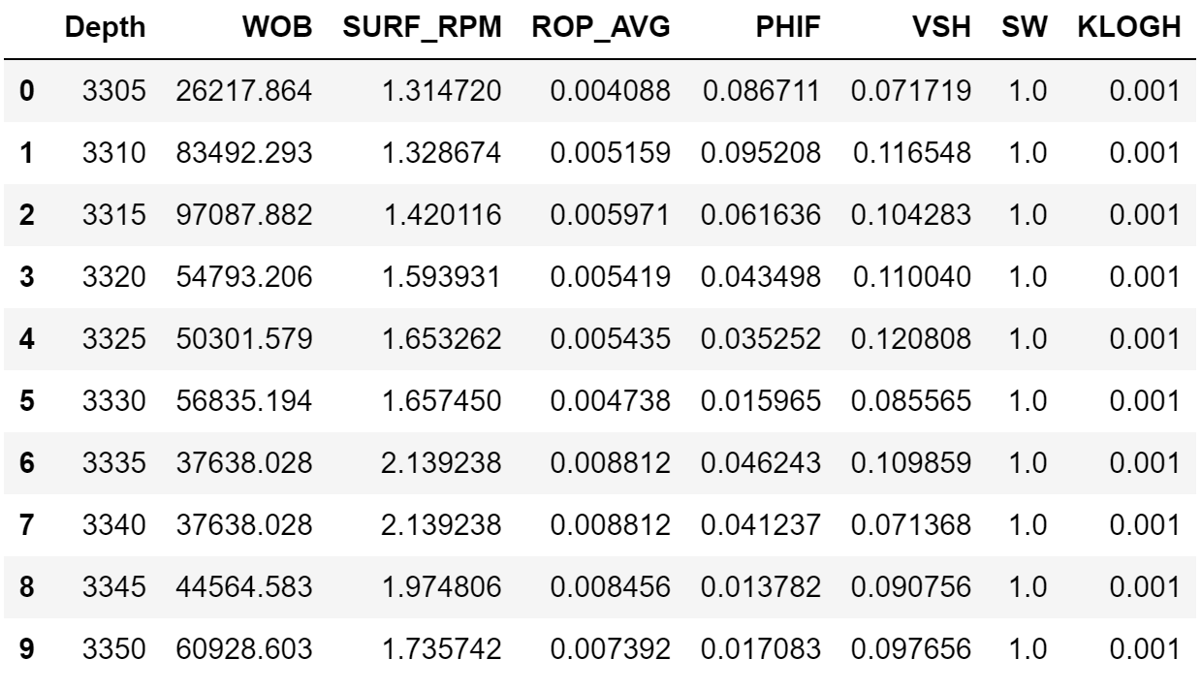
DATA ANALYSIS
The dataset that we are going to use is arranged from two original data; real-time drilling data and a Computed Petrophysical Output (CPO) log data from well number 15/9-F-15 in the Volve Oil Field in the North Sea.
The dataset consists of 8 columns, the WOB, SURF_RPM, and ROP_AVG are drilling parameters, while the remaining is petrophysical parameters.

Slide 7
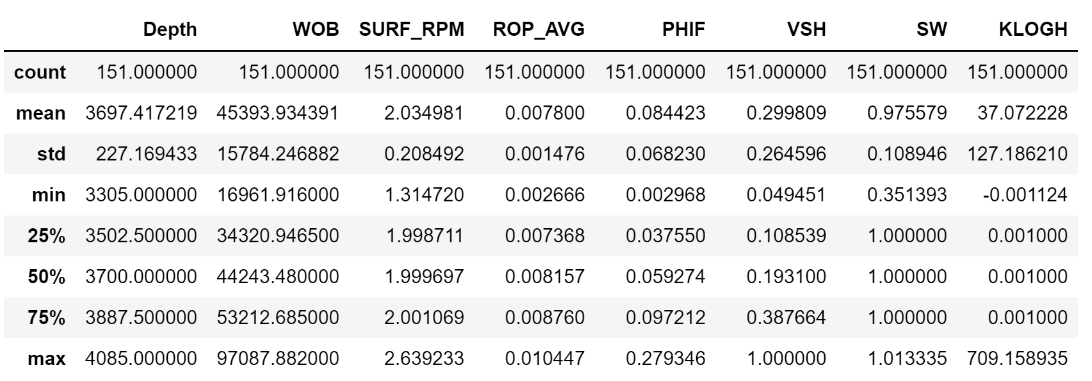
DATA ANALYSIS

Slide 8
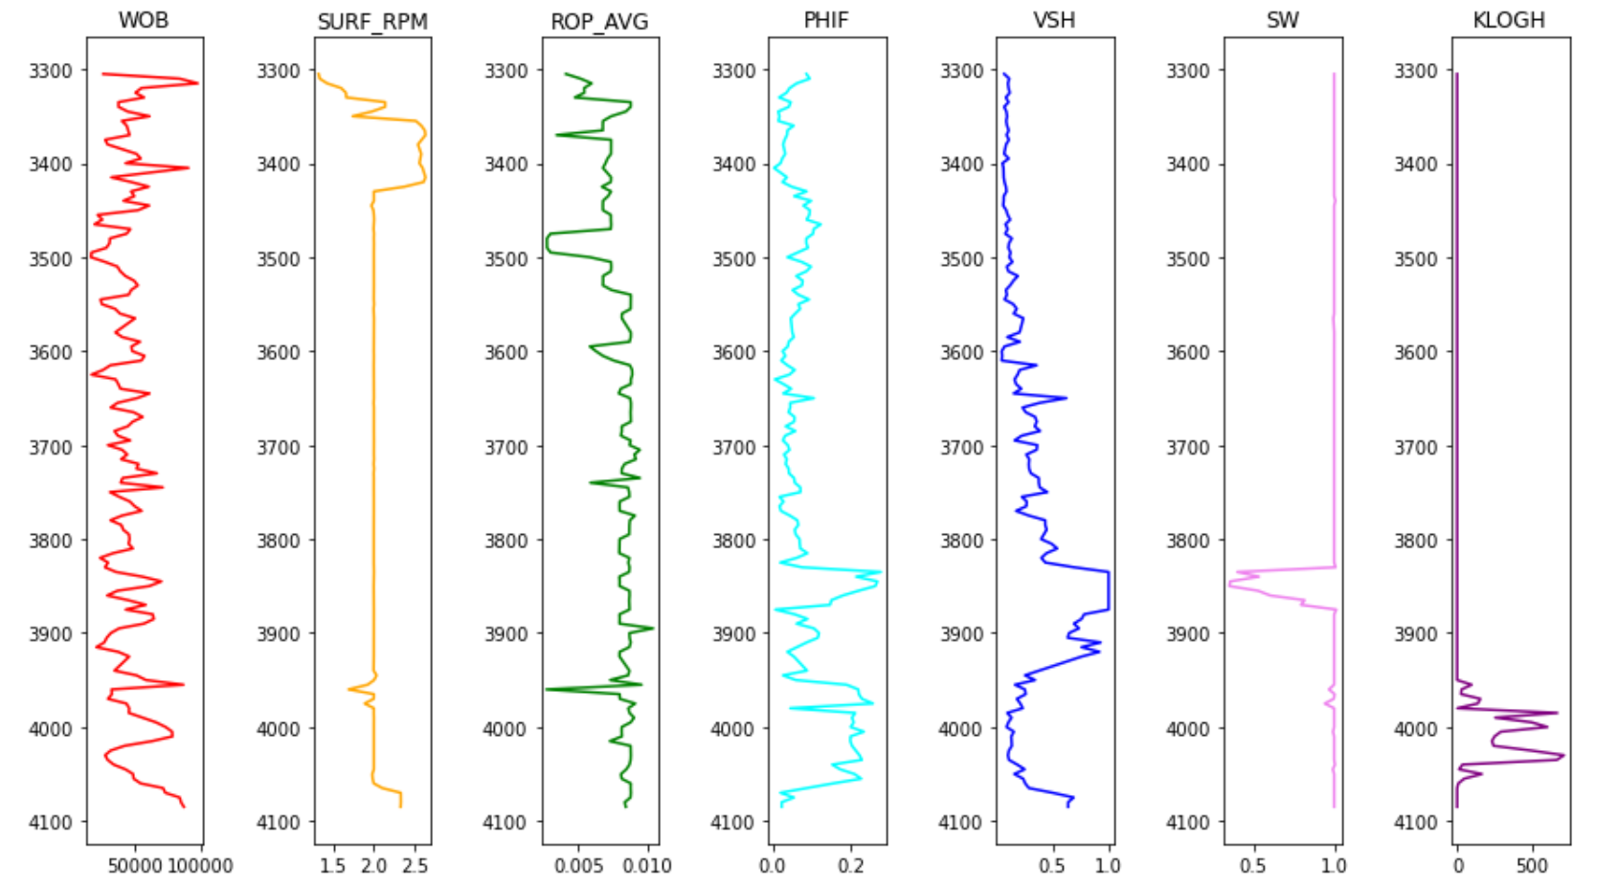
DATA ANALYSIS
Data is represented into a log to observe drilling parameters and petrophysical properties over depth.
Drilling Break

Slide 9
DATA ANALYSIS
At depth 3,480 – 3,500 m where the ROP drops to 0.002 m/s.
This could be either due to high formation pressure or insufficient WOB and RPM.
Since we do not have formation pressure, therefore we assume this is due to insufficient WOB and RPM.

Slide 10
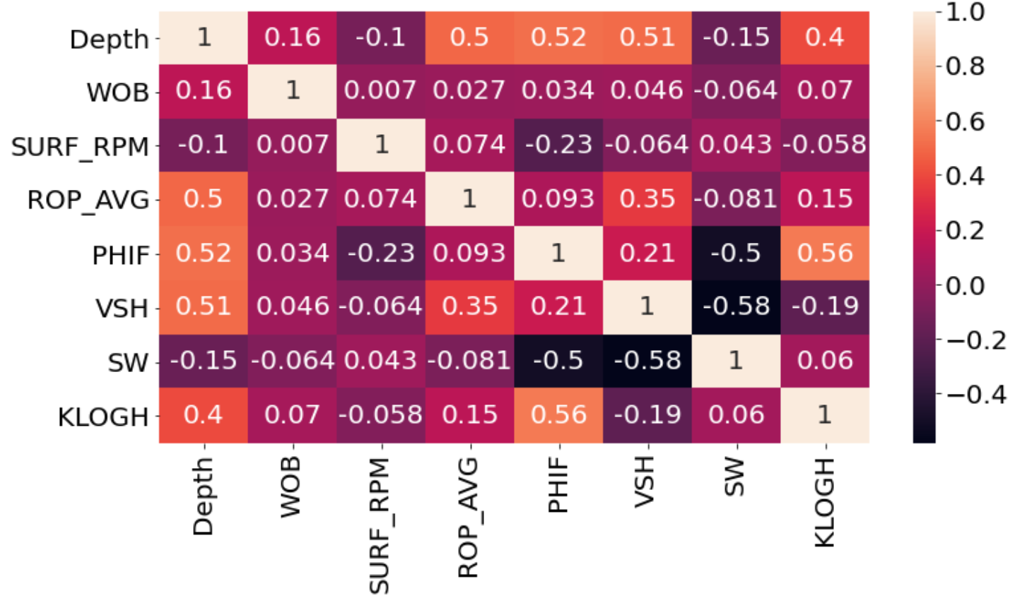
DATA ANALYSIS
Seaborn library is used to see the correlation between the parameters.
ROP seem to have a correlation with VSH (volume of shale).

Slide 11
DATA ANALYSIS
Looked for Multicollinearity and co relation between the variables

Slide 12
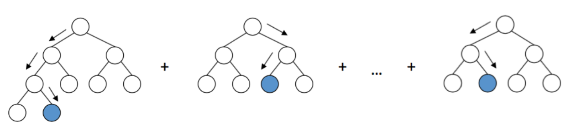
PREDICTIVE ANALYSIS
Gradient Boosting Machine
It combines the predictions from multiple decision trees to generate the final predictions.
It works by summing trees one-by-one; the 2nd tree is added to the 1st one as an ensemble (call it D1). We have a target function, call it f.
The difference (or residual) between f and D1 is the residual that will be minimized by the next 3rd tree.
It creates a new ensemble D2. Then this residual is calculated between f and D2, a new ensemble is born, and the process is repeated.

Slide 13
PREDICTIVE ANALYSIS
Gradient Boosting Machine for ROP prediction
ROP_AVG is separated from the remaining columns as the prediction target
the dataset was split into train and test set with a 20% test size.
A pipeline that consists of a standard scaler and Gradient Boosting was made.
Two Hyperparameter were set for our model; min_samples_leaf = 6 & max_depth=20
The training R-squared score was 98% and the test R-squared score was 77%.
Prediction was performed by using the model, the model predicts the ROP of 0.0051 m/s.

Slide 14
PREDICTIVE ANALYSIS
K-FOLD CROSS VALIDATION
ML model performance on training data is not a good indicator of its effectiveness as a predictor.
It's very easy to increase accuracy on a training dataset by overfitting a model, which can result in poorer performance on unseen data.
Using only one training/ test split to compare models can introduce bias towards certain models and lead to overfitting.

Slide 15
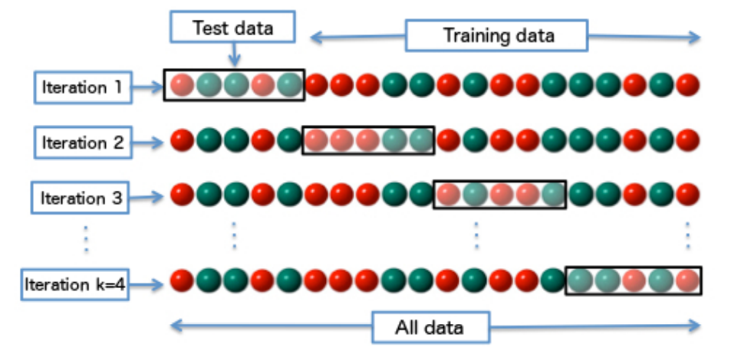
PREDICTIVE ANALYSIS
K-FOLD CROSS VALIDATION ALGORITHM
Split data into k "folds" of near-equal size.
Test and train k models on different fold combinations. Each model will include k - 1 folds of training data and the left-out fold is used for testing.
Calculate the model accuracy by taking the mean of the k values. The standard deviation is also calculated to provide error bars on the value.

Slide 16
PREDICTIVE ANALYSIS
K-FOLD CROSS VALIDATION ALGORITHM
K-Fold was performed with the 10 splits & and the shuffled dataset
Root Mean Squared value was recorded was 0.000209

Slide 17
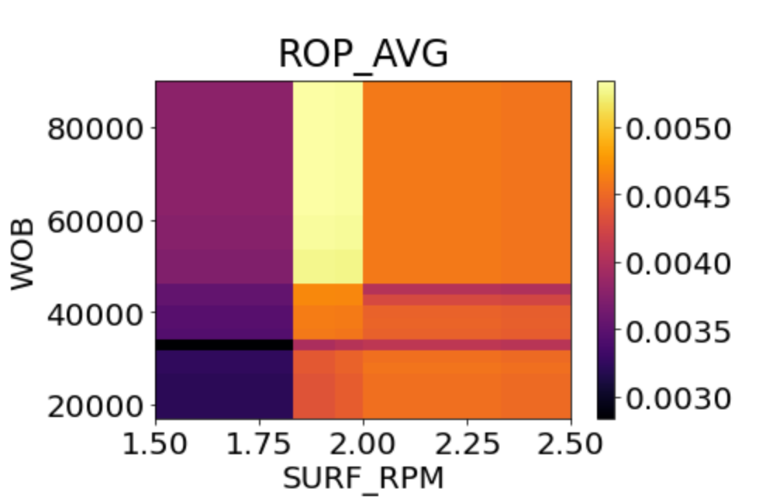
PREDICTIVE ANALYSIS
OPTIMIZATION WITH PARTICLE SWARM
ROP @ 3,480 m was optimized.
ROP was predicted as a function of WOB and RPM while other variables were kept constant.
Figure shows that at depth 3,480 m, high ROP achieved at 42,000 N when RPM is in range between 1.8-2.
Therefore, ROP was low because the WOB at that depth was only 31,000 N.

Slide 18
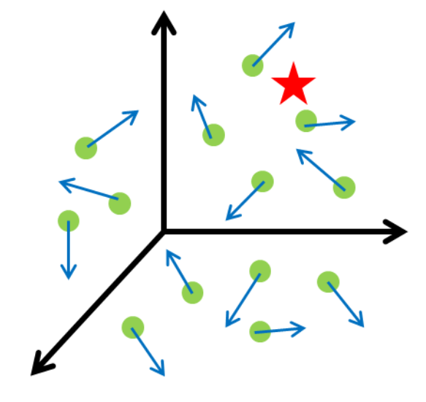
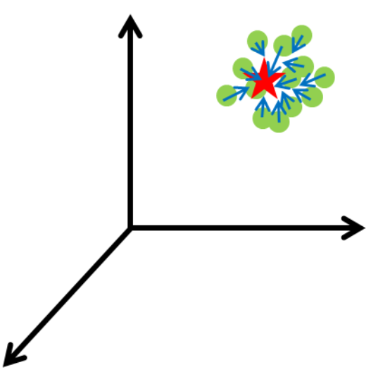
PREDICTIVE ANALYSIS
PARTICLE SWARM OPTIMIZATION (PSO)
An optimization algorithm based on the behavior of animal flocks.
PSO arranges several particles (swarms) in random positions that aligns to find a global solution after many iterations.

Slide 19
PREDICTIVE ANALYSIS
PARTICLE SWARM OPTIMIZATION (PSO)
PySwarm package was used to solve PSO optimization problem.
We searched for the values of WOB and RPM for this optimization.
PSO ran a maximum iteration of 1000.
Optimum ROP achieved was 0.0057 with 63,106 WOB.

